Slide 1
CSE713 PAPER REVIEW
Wireless body area network's application for motion detection based on Android smartwatch
Group 12
MD. TANVIR ZAHID_22366028
ST: Mehnaz Ara Fazal
RA: Sania Azhmee Bhuiyan

Slide 2
SUMMARY
WBAN
USE OF DIFFERENT SENSORS INTEGRATED IN SMARTWATCH

Slide 3
MOTIVATION

Slide 4
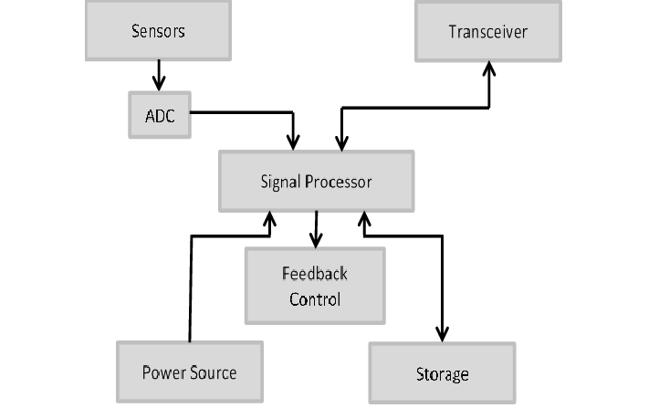
METHODOLOGY
Followed the Android development process

Slide 5
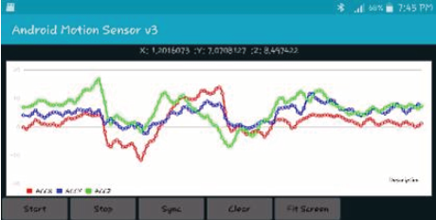
SYNTHESIS AND CONCLUSION
Result shows data from smartwatch to smartphone to a graph
Different sensor implemented in smartwatch from accelaration and orientation detection

Slide 6
FIRST LIMITATION
Faulty sensors

Slide 7
SECOND LIMITATION
Code complexation

Slide 8
END OF PRESENTATION

